Slide 1

Minerva college of education INDORA
Presentation on :
Relational Algebra and Relational Calculus
SUBMITTED BY : ANKITA KOUNDAL
ROLL NO. : 250008
SUBMITTED TO : MISS AMRIT KAUR

Slide 2

Content :-
Relational algebra
Introduction
Basic operations of relational algebra :
Unary operations
Selection
Projection
Rename
Binary operations
Union
Cartesian product
Set difference
Extended / Derived operations :
join
Division
Intersection
Advantages and disadvantages of relational algebra
Relational calculus
Definition
Types of Relational calculus
Tuple relational calculus
Domain relational calculus
Advantages and disadvantages of relational calculus

Slide 3
Introduction
Relational Algebra is a procedural query language used in DBMS to retrieve and manipulate (control or operate ) data stored in relational databases.
It is based on set theory .
It works on relations (tables).
It tells how to get the result (step by step procedure).
It was proposed by E.F. Codd in 1970 along with the relational model .

Slide 4
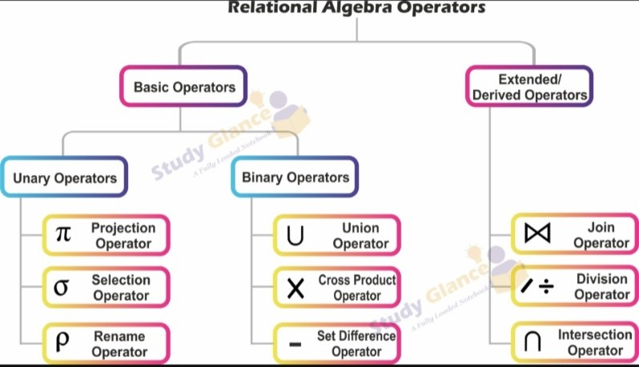
Basics operations of relational algebra

Slide 5
Operations :-
Relational Algebra is a procedural query language used to retrieve data from relational databases. It works on relations (tables) and produces a new relation as result.
Operations in Relational Algebra are mainly divided into:
Unary Operations (Single relation required)
Binary Operations (Two relations required

Slide 6
Types of Basic operations
Unary operation
Binary operation

Slide 7
Unary operations
In Relational Algebra unary operations are those operations that are applied on only one relation (table) at a time .
They do not require two relations
There are mainly three unary operations:
Types of unary operations
Selection σ
Projection
Rename

Slide 8
SELECTION OPERATION
Definition : Selection operation is a unary operation in Relational
Algebra .
It is used to specific tuples (rows) from a relational that satisfy a given
condition.
It performs horizontal filtering of data .
Symbol : Selection is represented by the Greek letter :
σcondition (Relation)
Where : σ(sigma) = Selection operation
condition = Condition to filter rows
Relation = Table name

Slide 9
Example :- Consider a relation : Student
Select students whose Course is BCA
σcourse =‘BCA’​(Student)
Roll no | Name | Age | Course
1 | Asha | 19 | BCA
2 | Ravi | 21 | BBA
3 | Neha | 20 | BCA
4 | Aman | 22 | BCom

Slide 10
Result :
Types of Conditions used in Selection operation:
Selection uses comparison operators and logical operators .
Roll no | Name | Age | Course
1 | Asha | 19 | BCA
3 | Neha | 20 | BCA

Slide 11
1️⃣ Comparison (Relational) Operators :
Operator | Meaning | Example
= | Equal to | σ_{Age = 20}(Student)
≠ | Not equal to | σ_{Dept ≠ 'IT'}(Employee)
> | Greater than | σ_{Salary > 50000}(Employee)
< | Less than | σ_{Marks < 40}(Student)
≥ | Greater than or equal to | σ_{Age ≥ 18}(Student)
≤ | Less than or equal to | σ_{Marks ≤ 90}(Student)

Slide 12
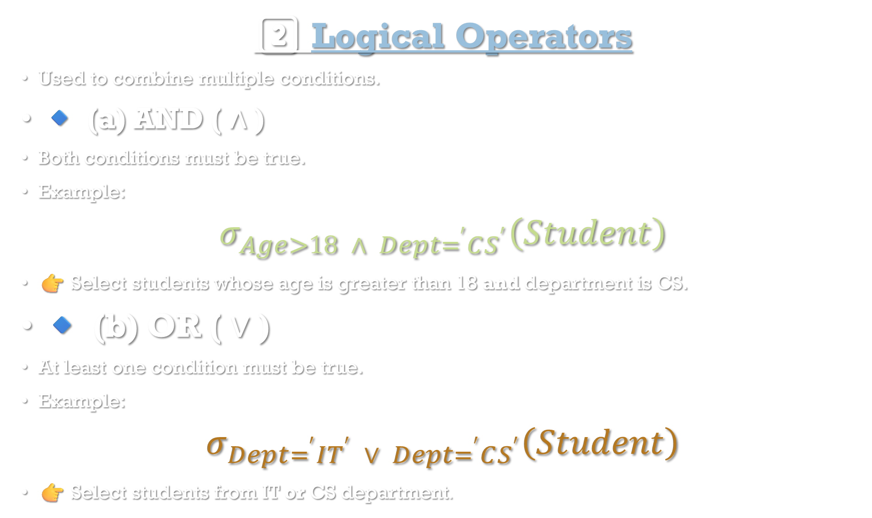
2️⃣ Logical Operators
Used to combine multiple conditions.
🔹 (a) AND ( ∧ )
Both conditions must be true.
Example:
$$σ_{Age>18 ∧ Dept=^{′}CS^{′}}\left(Student\right)$$
👉 Select students whose age is greater than 18 and department is CS.
🔹 (b) OR ( ∨ )
At least one condition must be true.
Example:
$$σ_{Dept=^{′}IT^{′} ∨ Dept=^{′}CS^{′}}\left(Student\right)$$
👉 Select students from IT or CS department.

Slide 13
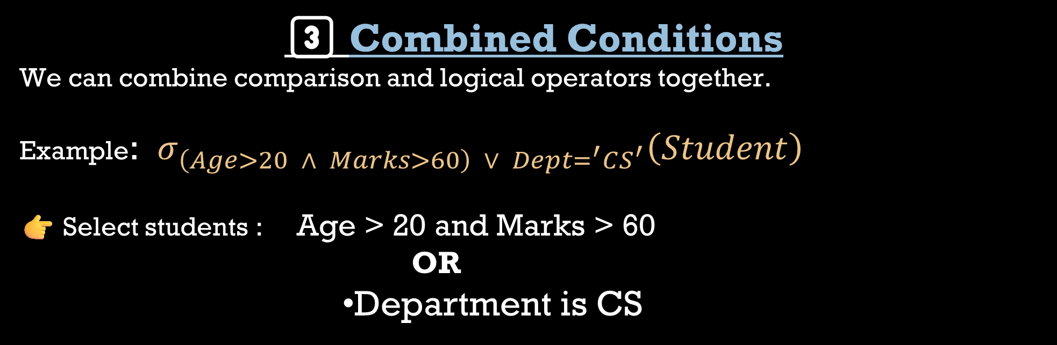

(c) NOT ( ¬ )
Used to negate a condition.
Example: $σ_{¬\left(Dept=^{′}IT^{′}\right)}\left(Employee\right)$
👉 Select employees who are not in IT department.
3️⃣ Combined Conditions
We can combine comparison and logical operators together.
Example: $σ_{\left(Age>20 ∧ Marks>60\right) ∨ Dept=^{′}CS^{′}}\left(Student\right)$
👉 Select students : Age > 20 and Marks > 60 OR
Department is CS

Slide 14
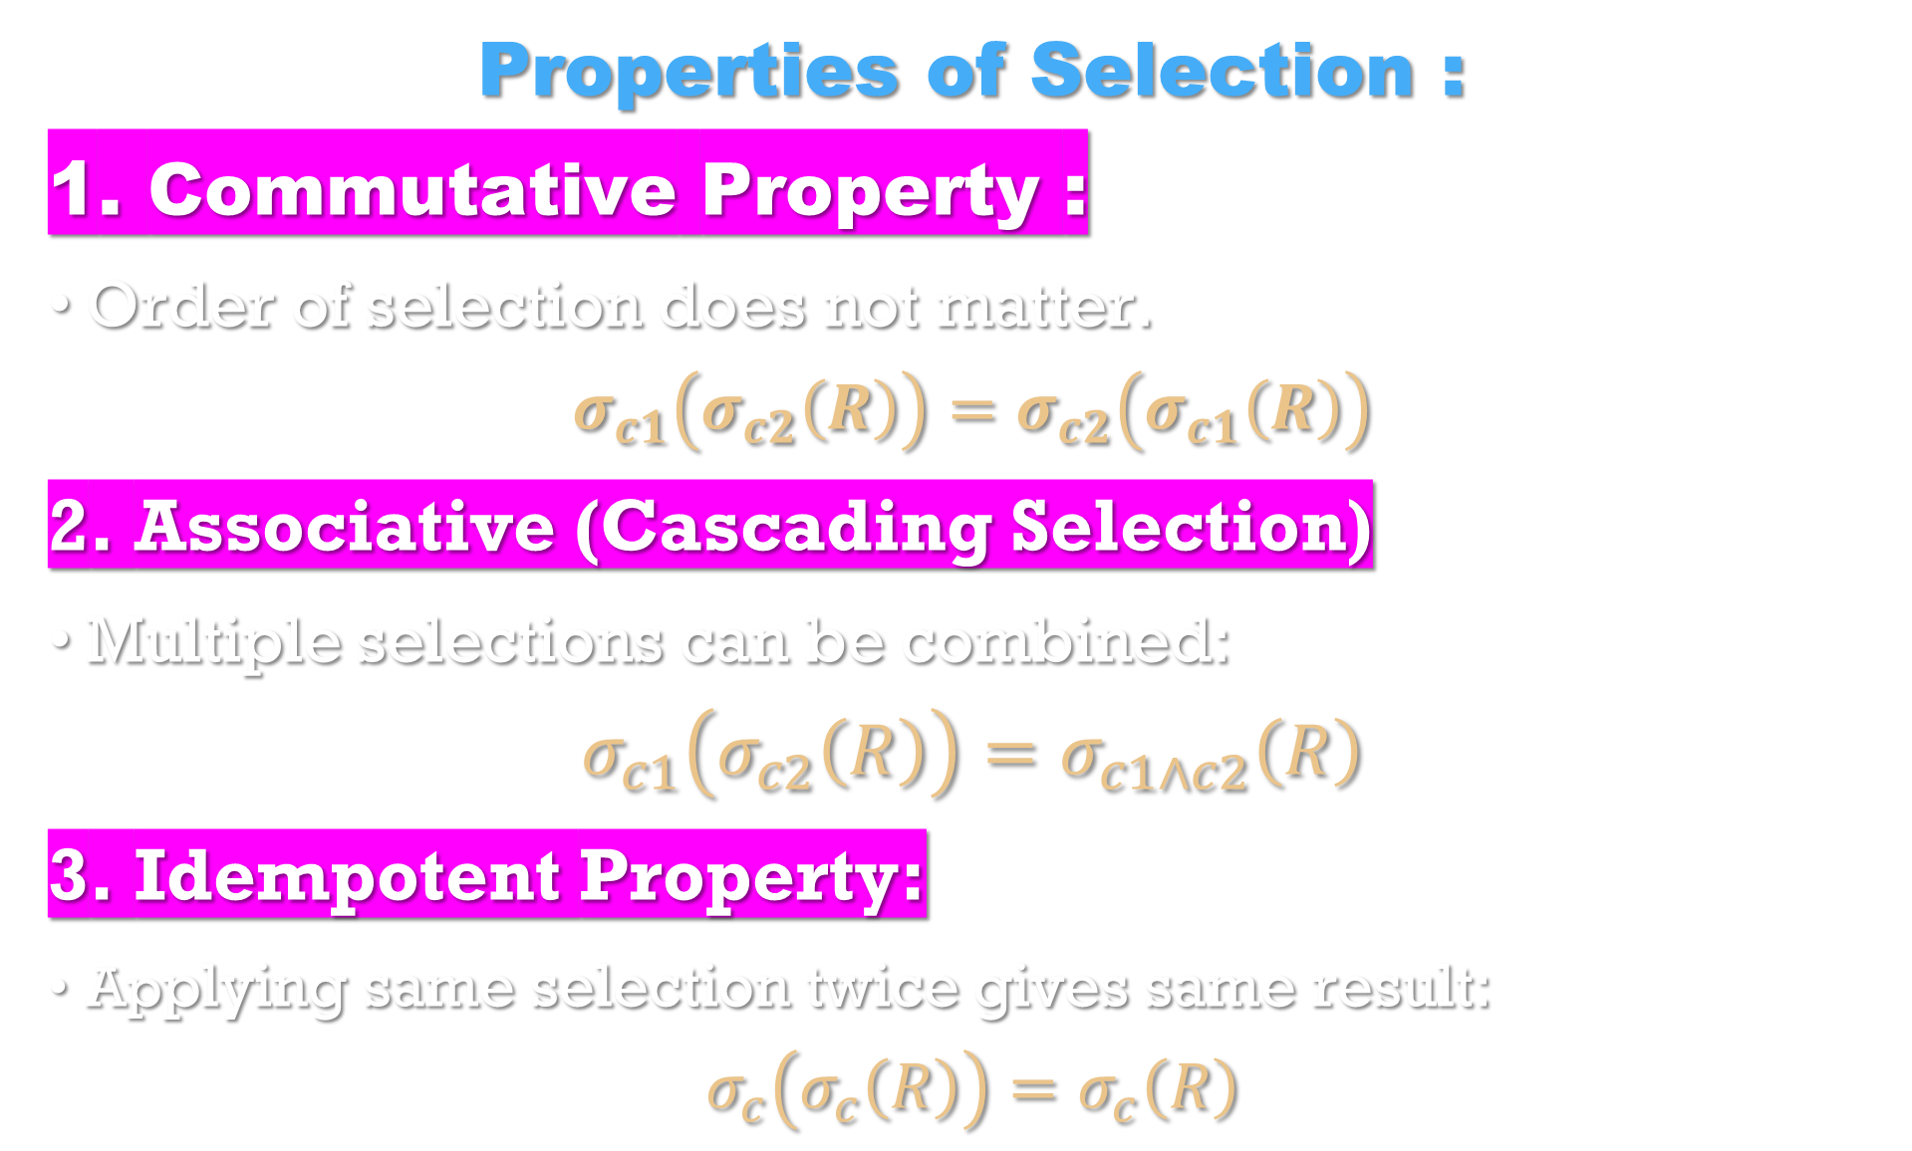
Properties of Selection :
1. Commutative Property :
Order of selection does not matter.
$$σ_{c1}\left(σ_{c2}\left(R\right)\right)=σ_{c2}\left(σ_{c1}\left(R\right)\right)$$
2. Associative (Cascading Selection)
Multiple selections can be combined:
$$σ_{c1}\left(σ_{c2}\left(R\right)\right)=σ_{c1∧c2}\left(R\right)$$
3. Idempotent Property:
Applying same selection twice gives same result:
$$σ_{c}\left(σ_{c}\left(R\right)\right)=σ_{c}\left(R\right)$$

Slide 15
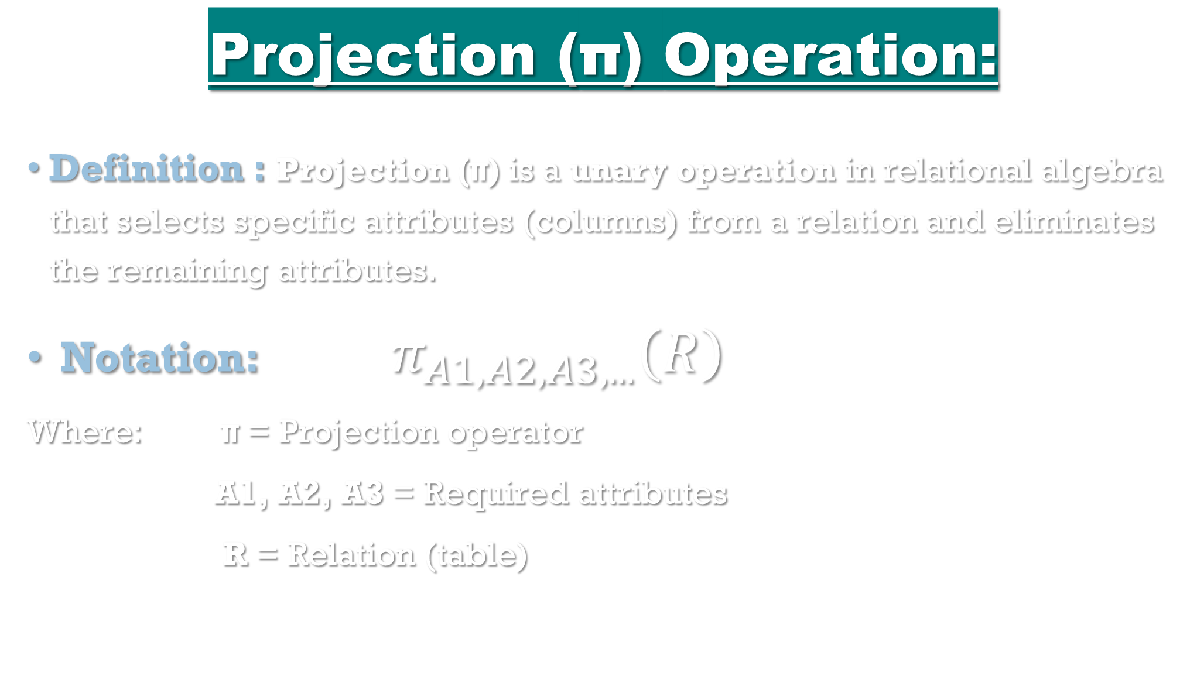
Projection (π) Operation:
Definition : Projection (π) is a unary operation in relational algebra that selects specific attributes (columns) from a relation and eliminates the remaining attributes.
Notation: $π_{A1,A2,A3,...}\left(R\right)$
Where: π = Projection operator
A1, A2, A3 = Required attributes
R = Relation (table)

Slide 16

Example : Employee Relation
Emp-ID | Name | Dept | Salary
1 | Asha | IT | 50000
2 | Rahul | HR | 40000
3 | Asha | IT | 50000
Operation:
$π_{Name,Dept}\left(Employee\right)$
Result :
Duplicate (Asha, IT) is removed.
Name | Dept
Asha | IT
Rahul | HR

Slide 17
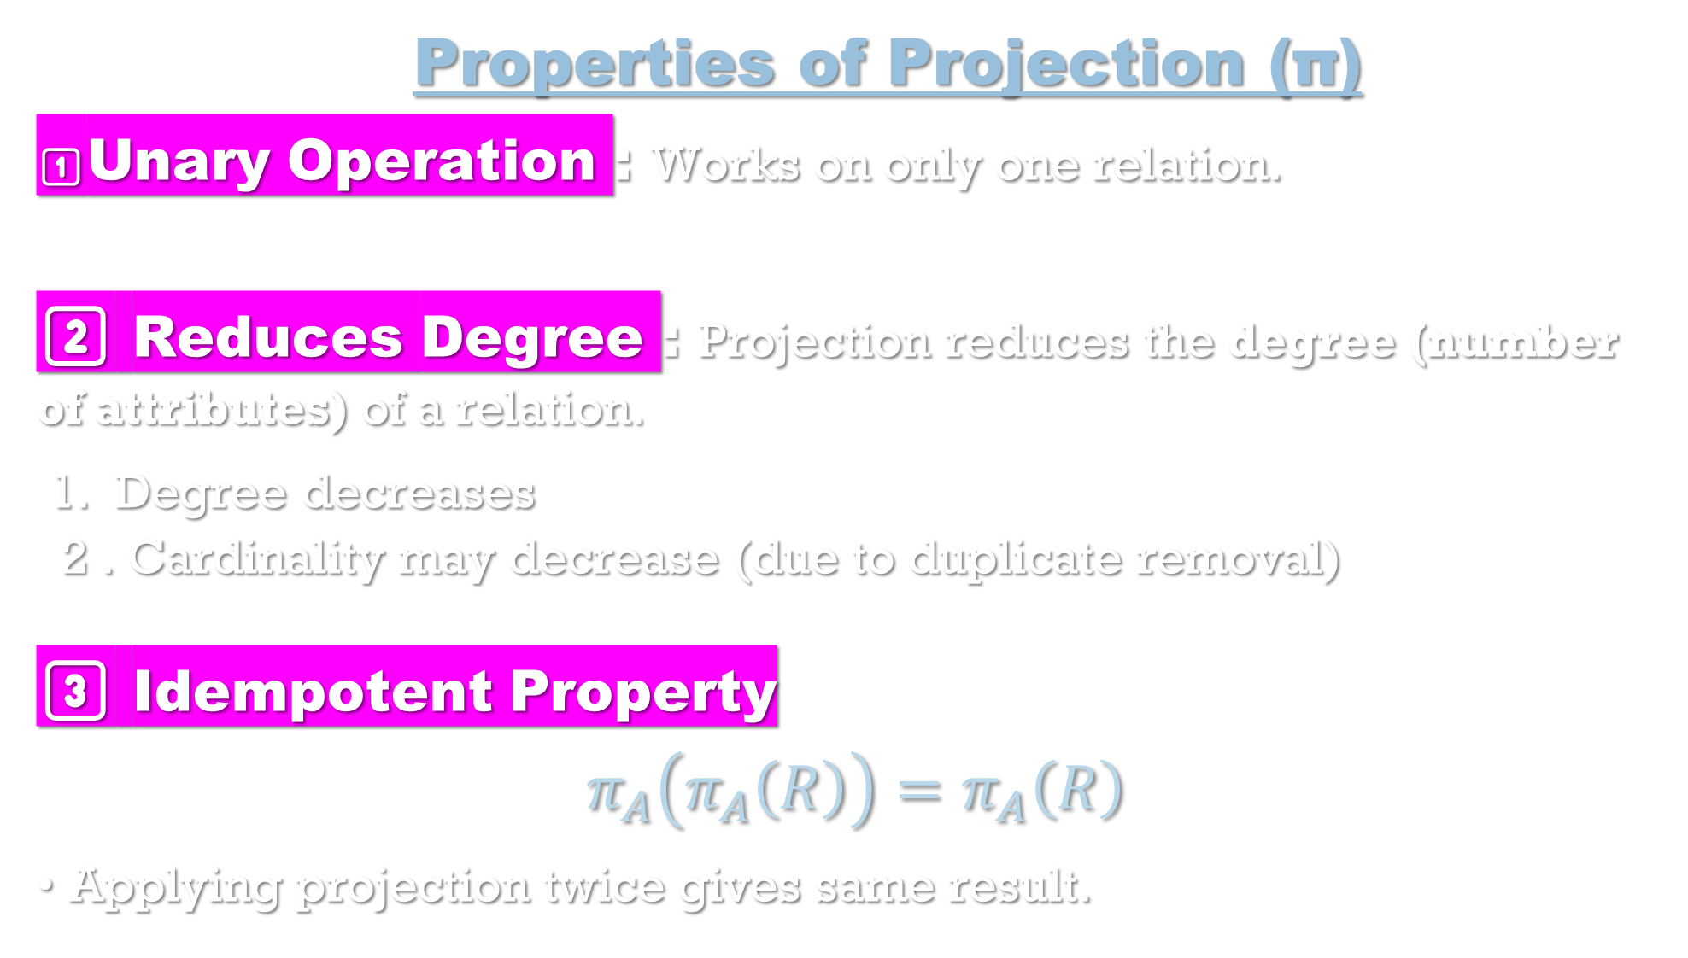
Properties of Projection (π)
1️⃣Unary Operation : Works on only one relation.
2️⃣ Reduces Degree : Projection reduces the degree (number of attributes) of a relation.
1. Degree decreases 2 . Cardinality may decrease (due to duplicate removal)
3️⃣ Idempotent Property
$$π_{A}\left(π_{A}\left(R\right)\right)=π_{A}\left(R\right)$$
Applying projection twice gives same result.

Slide 18
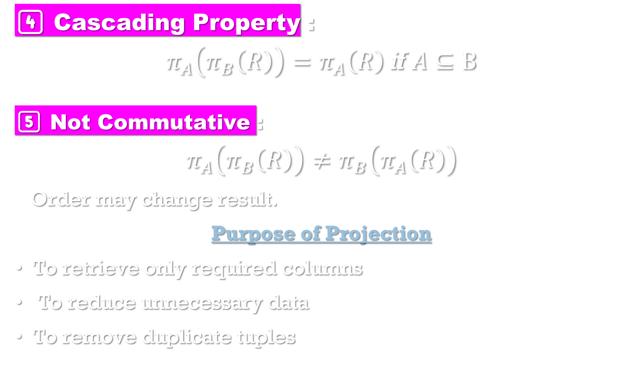
4️⃣ Cascading Property :
$$π_{A}\left(π_{B}\left(R\right)\right)=π_{A}\left(R\right) \text{if} A⊆B$$
5️⃣ Not Commutative :
$$π_{A}\left(π_{B}\left(R\right)\right)≠π_{B}\left(π_{A}\left(R\right)\right)$$
Order may change result.
Purpose of Projection
To retrieve only required columns
To reduce unnecessary data
To remove duplicate tuples

Slide 19
Rename (ρ) Operation
Definition : Rename (ρ) is a relational algebra operation used to rename a relation or its attributes (columns).
It is mainly used to:
Avoid ambiguity
Perform self-join
Give meaningful names to intermediate results

Slide 20
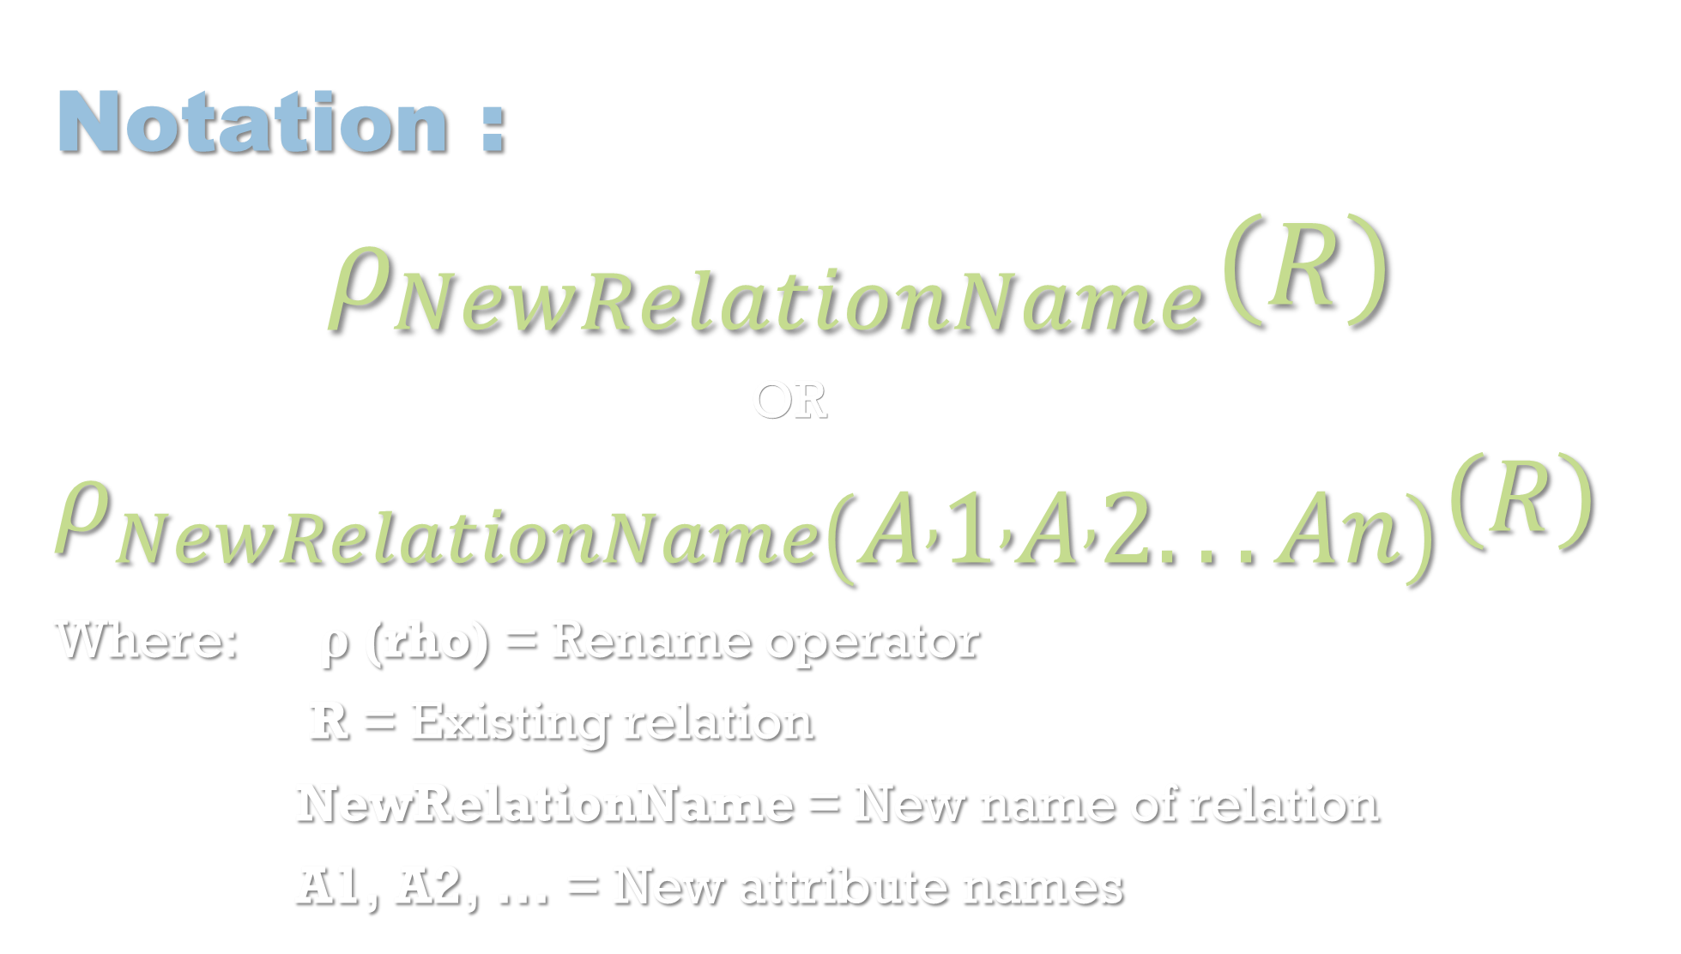
Notation :
$$ρ_{NewRelationName}\left(R\right)$$
OR $ρ_{NewRelationName\left(A , 1 , A , 2...An\right)}\left(R\right)$
Where: ρ (rho) = Rename operator
R = Existing relation
NewRelationName = New name of relation
A1, A2, ... = New attribute names

Slide 21

Example : Original Relation: Student
Operation:
$$ρ_{Stud\left(R , n , oSnameScore\right)}\left(Student\right)$$
Result :
Roll No | Name | Marks
1 | Riya | 80
2 | Aman | 75
Rno | Sname | Score
1 | Riya | 80
2 | Aman | 75

Slide 22
Properties of Rename (ρ)
1️⃣ Unary Operation : Works on only one relation.
2️⃣ Does Not Change Data : Only changes
Relation name
Attribute names
Data remains same.
3️⃣ Degree and Cardinality Remain Same : Number of attribute – Same
Number of tuples → Same

Slide 23

4️⃣ Essential for Self-Join :
When joining a table with itself, rename is necessary.
Example:
$ρ_{E1}\left(Employee\right)⋈ρ_{E2}\left(Employee\right)$

